Slide 1
Introduction to Biology
BB 101
Shamik Sen

Slide 2
Course Instructors
Shamik Sen
Room 605, BSBE
Email: shamiks@iitb.ac.in
Phone: 7743
Kiran Kondabagil
Room 601, BSBE
Email: kirankondabagil@iitb.ac.in
Soumyo Mukherji
Room 301, BSBE
Email: mukherji@iitb.ac.in

Slide 3
Course Structure & Schedule
2-1-0-6
2 Lectures/week
1 Tutorial/week
No Lab
6 Credits
Lectures
Tutorials
S1: Tue & Fr, 3.30 – 4.30 pm
S2: Wed & Fr, 11.05 – 12.05 pm

Slide 4
Tutorials
^{Dept. Slot Venue}
3rd Yr CL 14A Uploaded in Moodle
AE, MM, EN 3C Uploaded in Moodle
CL, CE 8B Uploaded in Moodle
2ndYr CH, 3rdYr EP 14A Uploaded in Moodle

Slide 5
Course Content
Physical Biology Shamik Sen
Cell and Molecular Biology Kiran Kondabagil
Biomedical Engineering Soumyo Mukherji

Slide 6
Text/References
Physical Biology of the Cell
Phillips, Kondev, Theriot, Garcia
2nd Edition, Garland Science
Campbell Biology
Reece, Urry, Cain, Wasserman, Minorsky, Jackson, Campbell
11th Edition, Cummings
Textbook of Medical Physiology
Hall, Guyton
10th Edition, Elsevier

Slide 7
Timeline of 3 divisions
Shamik Sen 23/7/2013 – 28/8/2013
Quiz: 14/8/2013
Kiran Kondabagil 30/8/2013 – 11/10/2013
Quiz: 9/10/2013
Soumyo Mukherji 15/10/2013 – 15/11/2013
Quiz: 6/11/2013

Slide 8
Evaluation & Grading
Quizes
3 main quizes 20 x 3
Quiz in each tutorial 5 x 13
Mid Sem Exam 50
End Sem Exam 100
Final Weightage (%)
25
25
50
Scores < 25 will fetch FAILGRADE
Remaining grades will be determined by class performance

Slide 9
What is Biology?

Slide 10
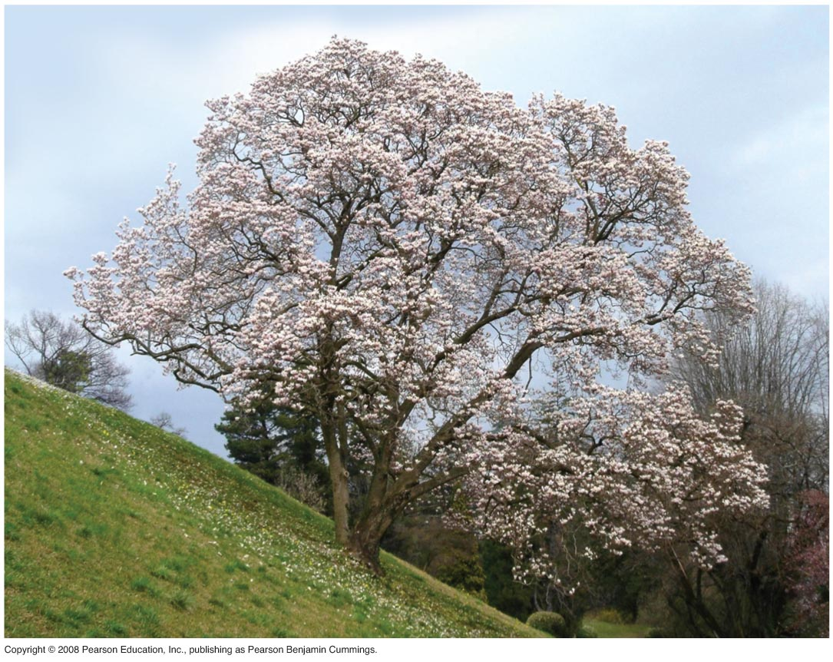
What is Biology?
Biology is the scientific study of life
Biologists ask questions such as:
How a single cell develops into an organism
How the human mind works
How living things interact in
communities

Slide 11
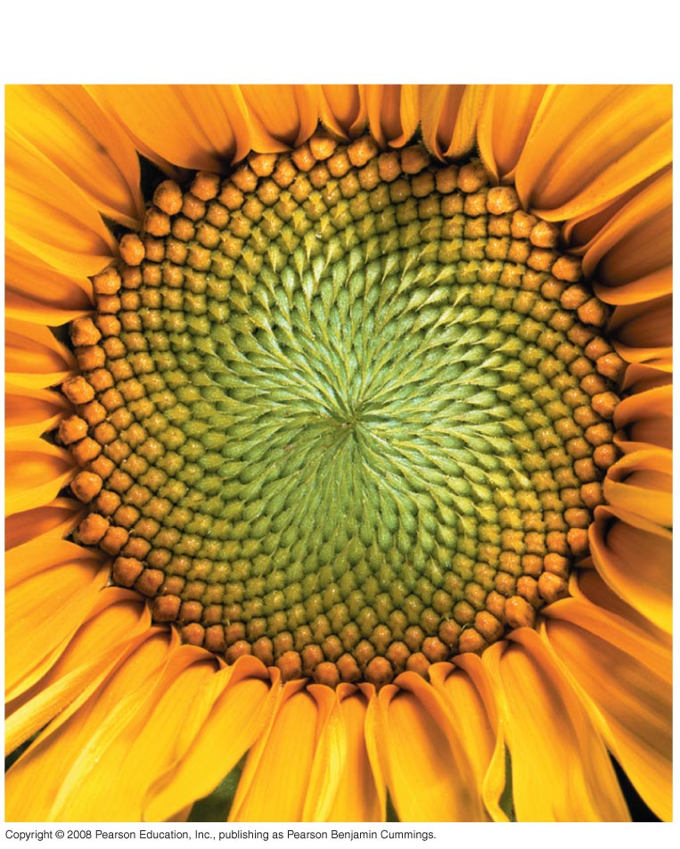
Properties of Life: Order
Notes:
Figure 1.3 Some properties of life

Slide 12
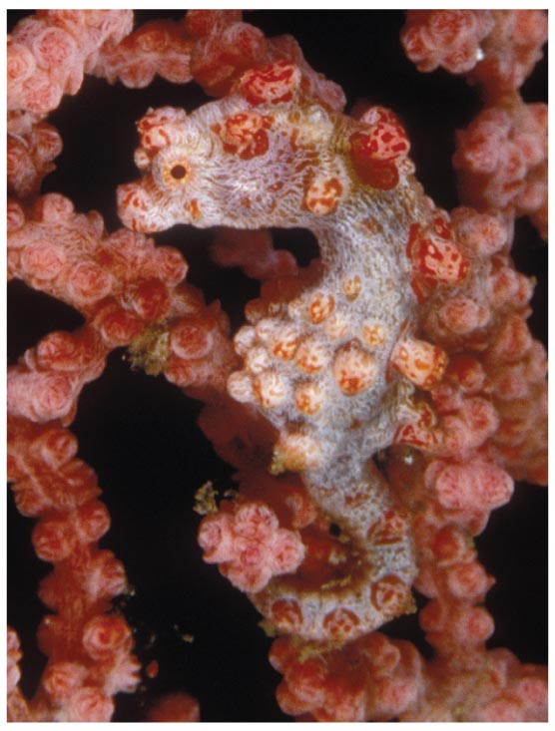
Properties of Life:
Evolutionary Adaptation
Notes:
Figure 1.3 Some properties of life

Slide 13
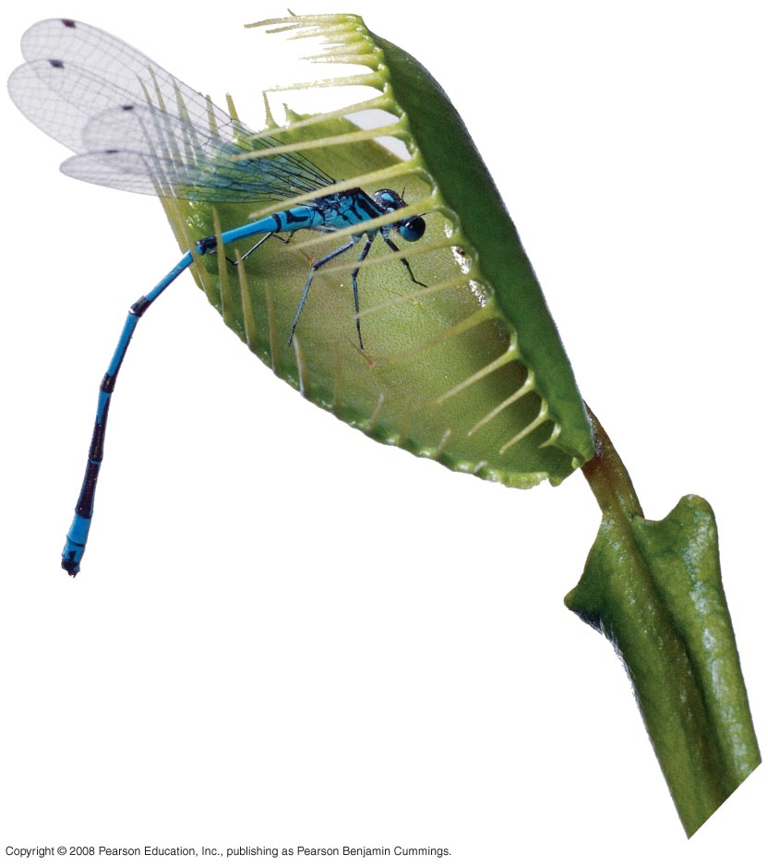
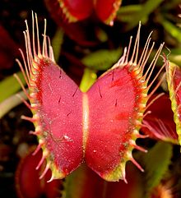
Properties of Life:
Response to stimuli
Venus fly trap
Notes:
Figure 1.3 Some properties of life

Slide 14
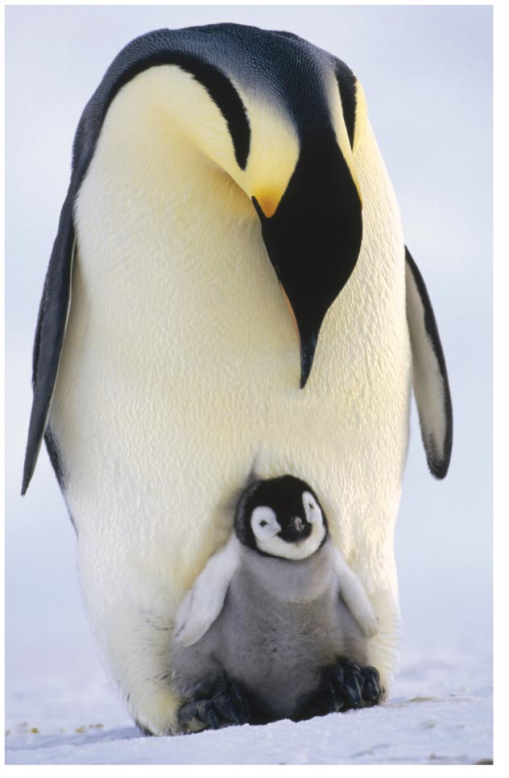

Properties of Life:
Reproduction
Notes:
Figure 1.3 Some properties of life

Slide 15
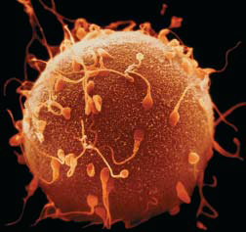
Properties of Life:
Development
A single ~200 μm cell, the human egg, with
sperm, which are also single cells. From the union of an egg
and sperm will arise the 10 trillion cells of a human body.
Notes:
Figure 1.3 Some properties of life

Slide 16
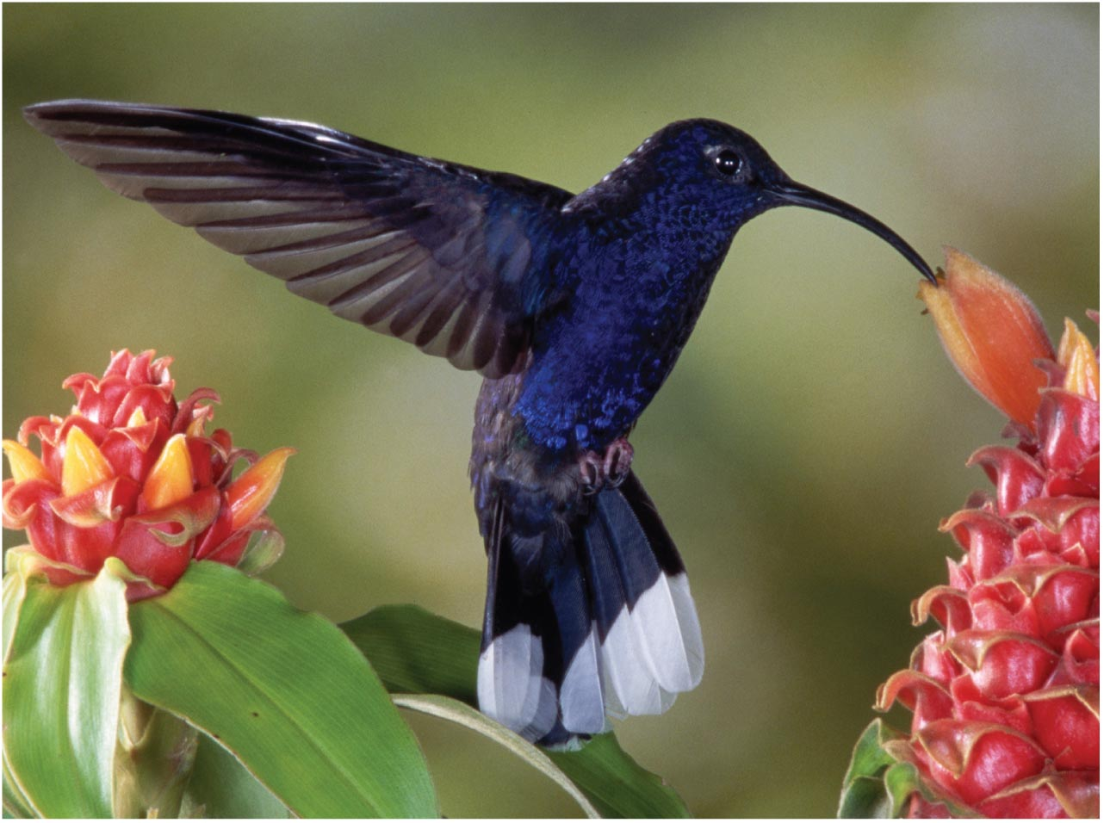
Properties of Life:
Energy Processing
Energy can be stored in different forms, for example, light, chemical, kinetic, or thermal
Energy flows through an ecosystem, usually entering as light and exiting as heat
Notes:
Figure 1.3 Some properties of life

Slide 17
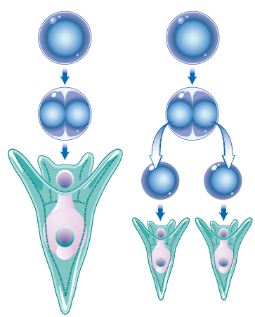
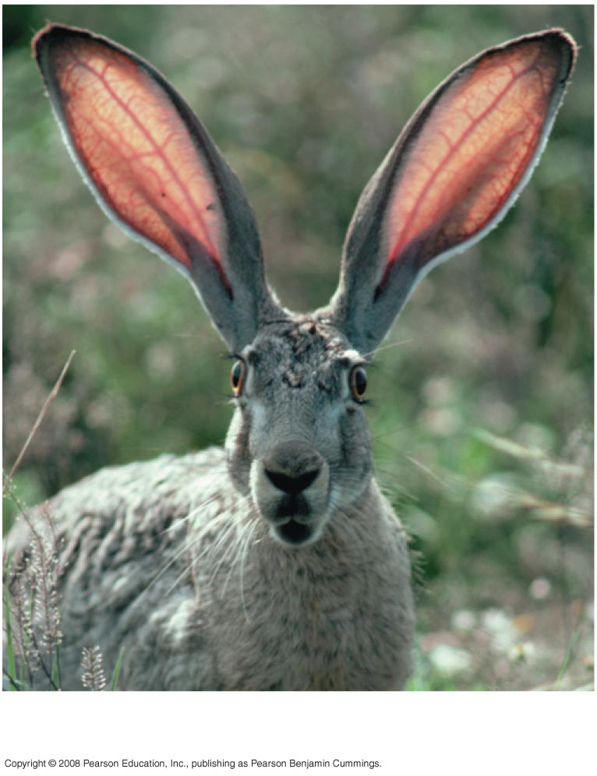
Properties of Life:
Self Regulation
Notes:
Figure 1.3 Some properties of life

Slide 18
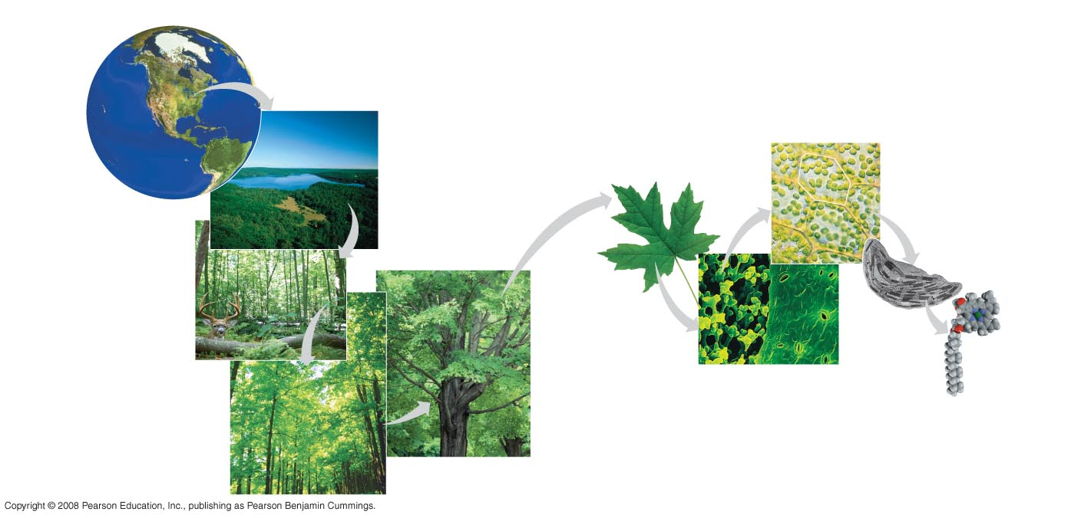
Levels of Biological Organization
Molecular Biology, Cell Biology, Physiology, Systems Biology, etc
The biosphere
Cells
Organs and organ systems
10 µm
Cell
Ecosystems
Organelles
Communities
1 µm
Atoms
Tissues
50 µm
Populations
Molecules
Organisms

Slide 19
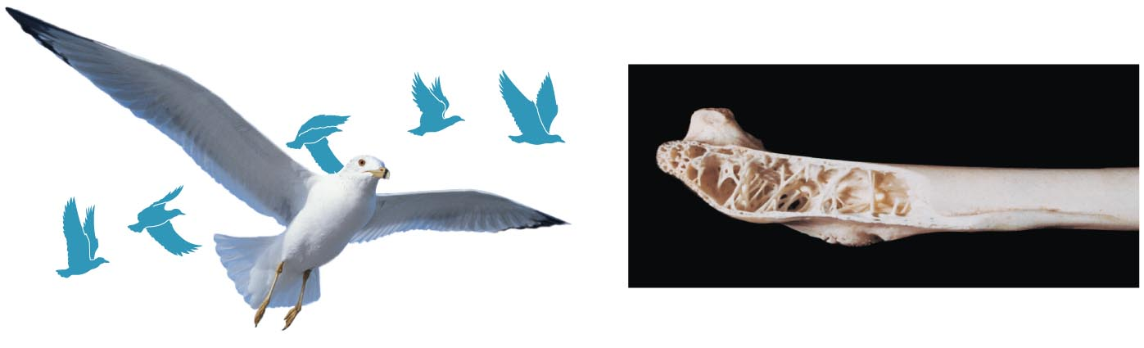
Structure-function correlation
Wing bones have a honeycombed internal structure that is strong but light weight

Slide 20
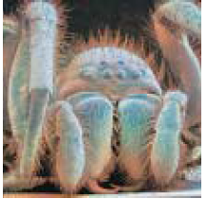
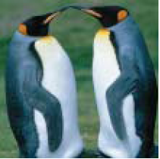
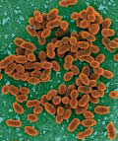
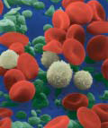
Fundamentals of Cell Theory
~10’s of μm’s
~mm’s
~m’s
All organisms are composed of one or more cells.
Cell is the structural unit of life.
Cells arise only by division from a pre-existing cell.

Slide 21
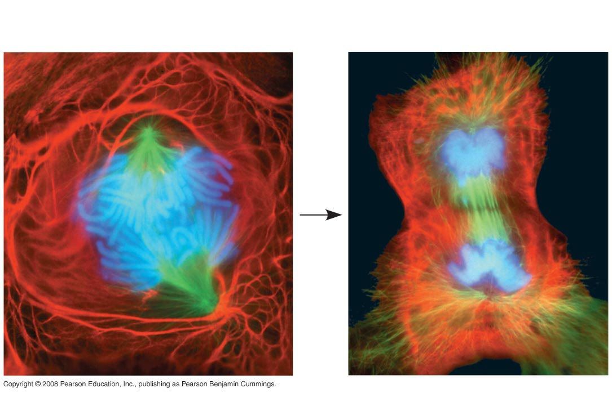
25 µm
A lung cell from a newt divides into two smaller cells that will grow and divide again
Notes:
Figure 1.7 A lung cell from a newt divides into two smaller cells that will grow and divide again

Slide 22
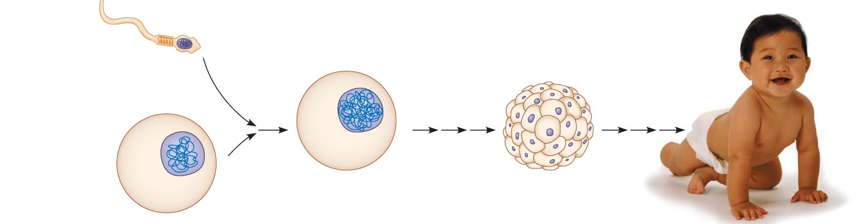
Inherited DNA directs the development of an organism
DNA consists of a string of genes.
Genes control protein production indirectly
DNA is transcribed into RNA then translated into a protein
An organism’s genome is its entire set of genetic instructions
Notes:
Figure 1.9 Inherited DNA directs development of an organism

Slide 23
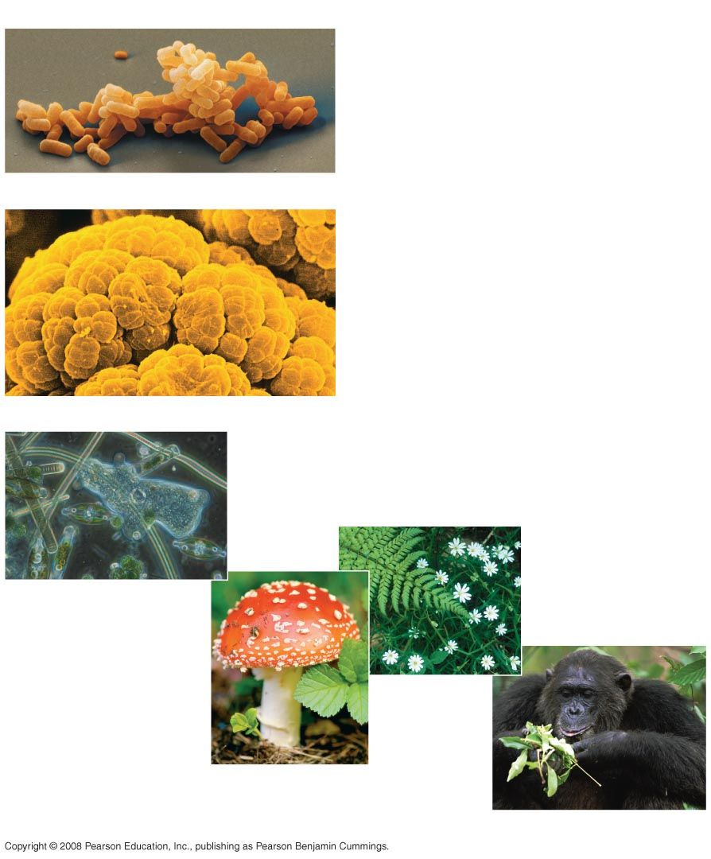
The Three Domains of Life
Domain Bacteria
Domain Archaea
Domain Eukarya

Slide 24
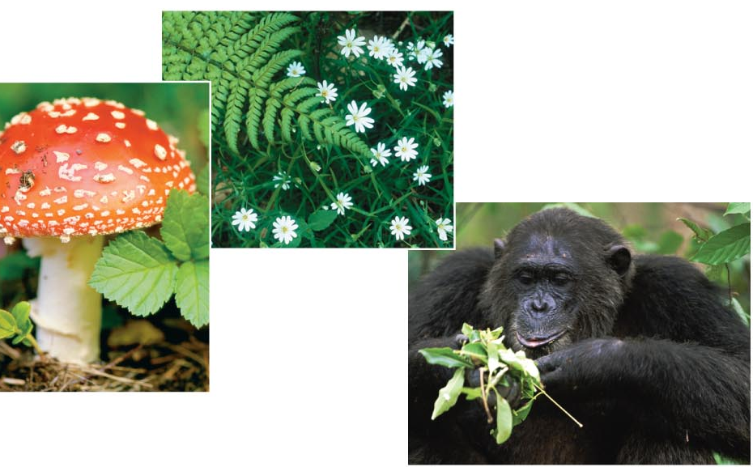
Domain Eukarya
The domain Eukarya includes three multicellular kingdoms:
Fungi Plantae Animalia

Slide 25
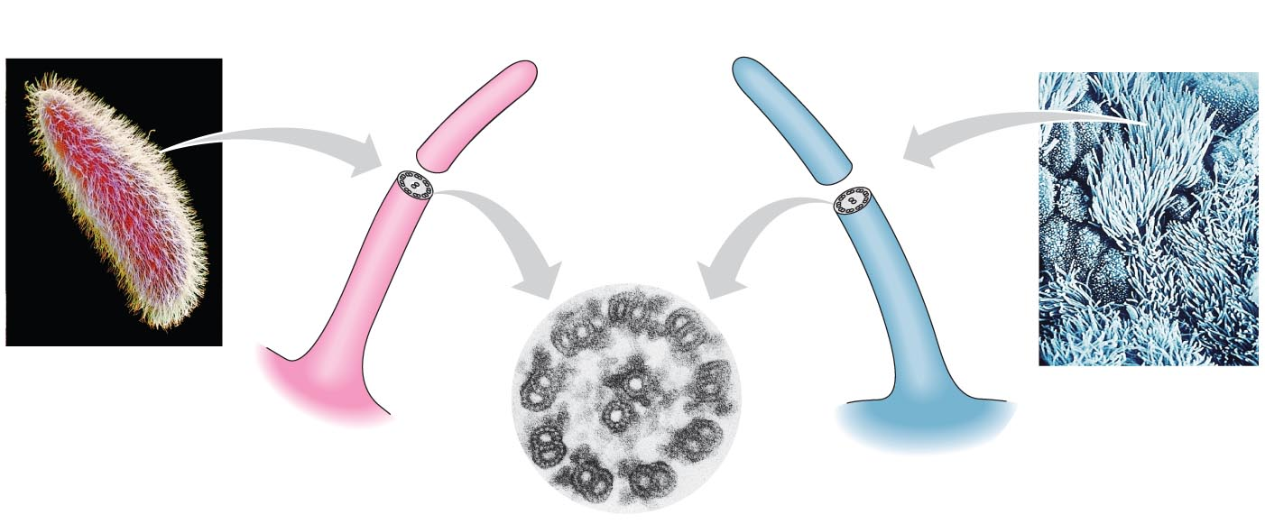
Unity in the Diversity of Life
DNA is the universal genetic language common to all organisms
Unity is evident in many features of cell structure
Cilia
Paramecium
Windpipe cells

Slide 26
Biology for engineers?

Slide 27
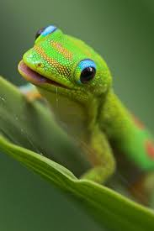
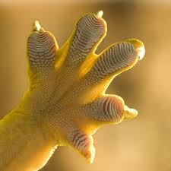
Lessons from Gecko
Gecko: heaviest animal to stand on the ceiling

Slide 28
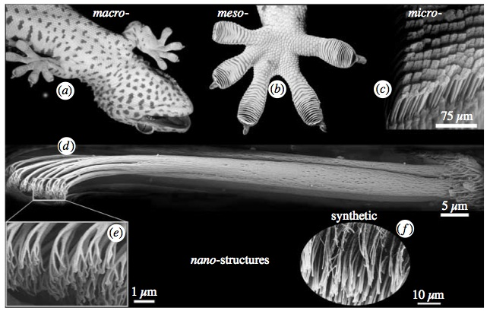
Designing “dry adhesives” to mimic gecko feet

Slide 29
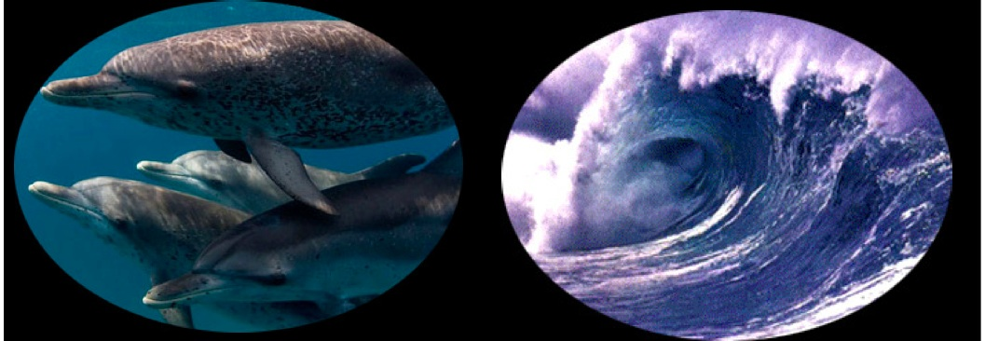
Tsunami Warning System
High performance under-water modem

Slide 30
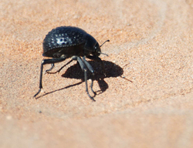
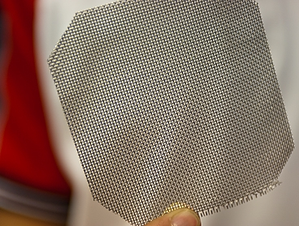
Fog Harvesting: Desert Beetle
Microscale bumps with hydrophilic tips catch water from fog
Design of fog catching nets mimicking beetle backs

Slide 31
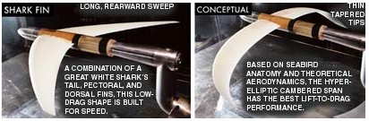
Design of Aeroplane Wings
Minimize Drag
Maximize Lift
Minimize Runway for landing

Slide 32
Engineering in Biology!

Slide 33
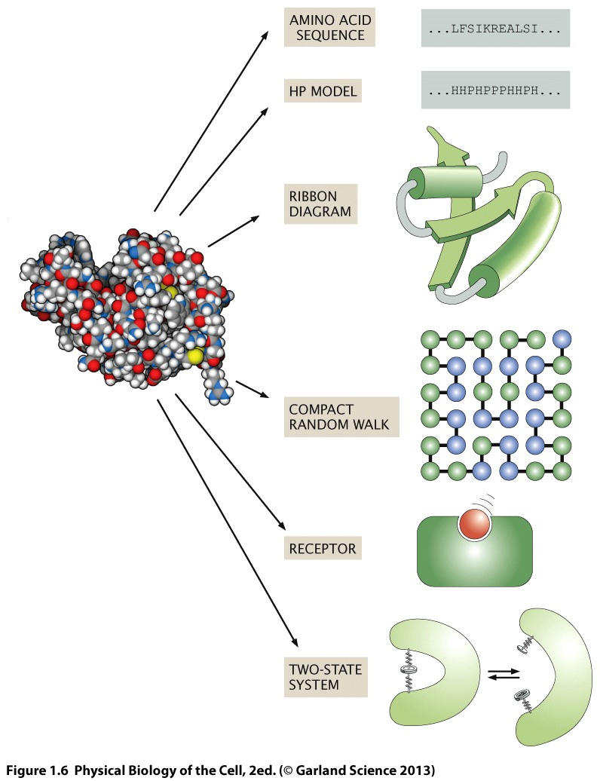
Predicting protein structure

Slide 34
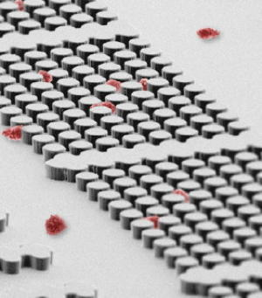
Devices for “Cell Separation”

Slide 35
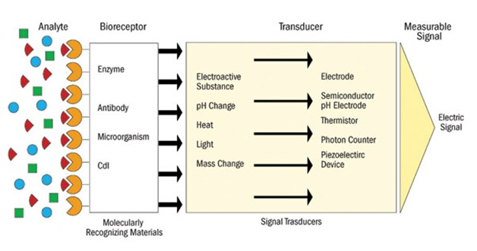
Developing Biosensors

Slide 36
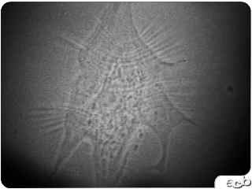
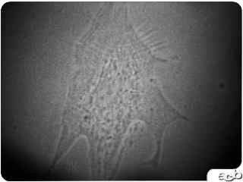
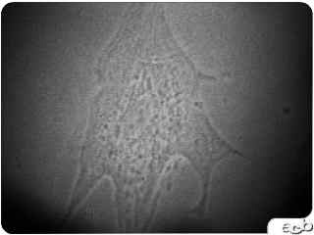

Measuring forces exerted by cells
time

Slide 37
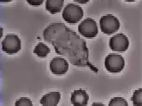
Quantifying “phagocytosis”

Slide 38
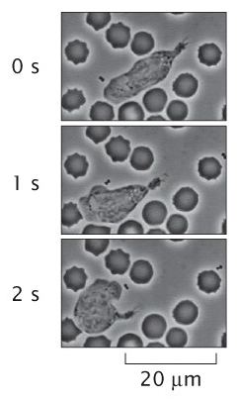
Biology: an Interdisciplinary Field
Phagocytosis
Biologist: What molecules are important?
Physicist: How does “target shape” matter?
Mechanical Engineer: Forces of interaction?
Chemical Engineer: Effect of confinement?
Mathematician: Modeling Chemotaxis

Slide 39
Interdisciplinary Research @ IITB
Ranjith Padinhateeri (BSBE): Chromosome positioning
Mandar Inamdar (Civil): Cell Mechanics
Mahesh Tirumkudulu (ChE): Bacteria motility
Debjani Paul (BSBE): Immune Response (Phagocytosis)
Soumyo Mukherji (BSBE): Biosensors
Dibyendu Das (Physics): Collective cell migration

